Slide 1


Deep Recursive Network Embedding with Regular Equivalence
Group 3:
OR man
Yaniv sokolov
Ilan meikler
Yaniv idov

Slide 2

Purpose of the article
In general:
Given a graph, embed the graph inside K dimension vector space, using regular equivalence.
We will digest this sentence in this presentation

Slide 3


What is embeDdings
Given group of objects( i.e., movies) embeddings let us rate the objects in multiple dimension form. For example:
Length
PG rate
Movie genres
This gives us the ability to define “distance” between different objects.
$$where U is set of Objects$$
$$embedding will be f:U→ℝ^{k}$$
$$where k∈ℕ is the dimantion of the embedding$$

Slide 4
What is similarity in graph
Degree equivalence
Structural equivalence
Regular equivalence

Slide 5

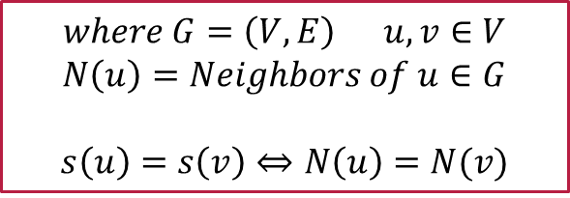
Structural equivalence
“Tell me who your friends are, and I will tell you who you are”
Are you associate with the same kind of people.
$$where G=\left(V,E\right) u,v∈V$$
$$N\left(u\right)=Neighbors of u∈G$$
$$s\left(u\right)=s\left(v\right)⇔N\left(u\right)=N(v)$$

Slide 6
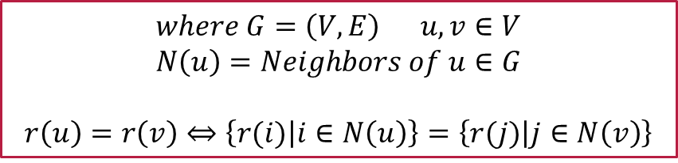
Regular equivalence
$$where G=\left(V,E\right) u,v∈V$$
$$N\left(u\right)=Neighbors of u∈G$$
$$r\left(u\right)=r\left(v\right)⇔\left\{r(i) | i∈N\left(u\right)\right\}=\left\{r(j) | j∈N\left(v\right)\right\}$$
Are you associate with the same kind of people?

Slide 7
Regular equivalence Properties
$$where G=\left(V,E\right) u,v∈V$$
$$N\left(u\right)=Neighbors of u∈G$$
$$r\left(u\right)=r\left(v\right)⇔\left\{r(i) | i∈N\left(u\right)\right\}=\left\{r(j) | j∈N\left(v\right)\right\}$$

Slide 8
Project flow
Set initial embeddings
sample the neighborhood
sort the neighbors of each vertex by their degree
aggregate the embeddings of the neighbors
using Layer-normalized LSTM into the embeddings of the vertex
repeat

Slide 9
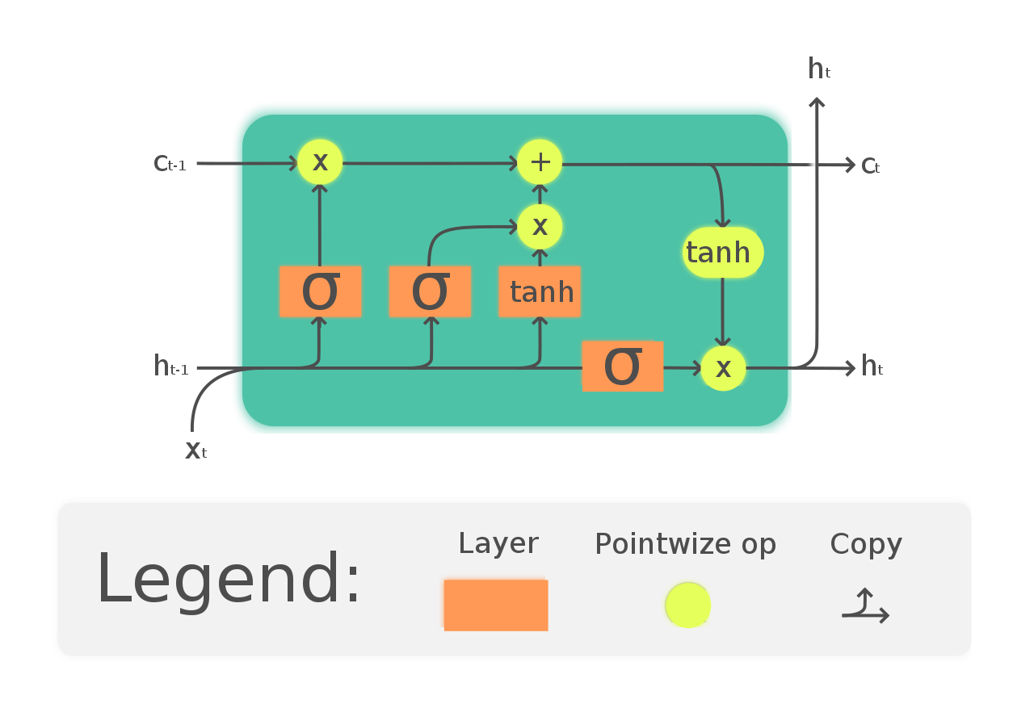
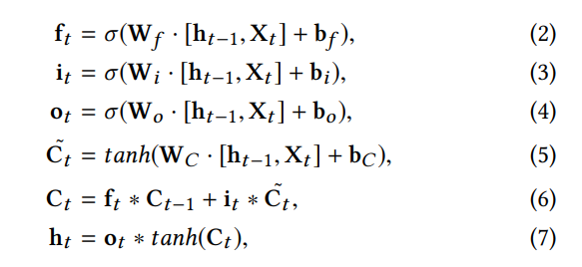
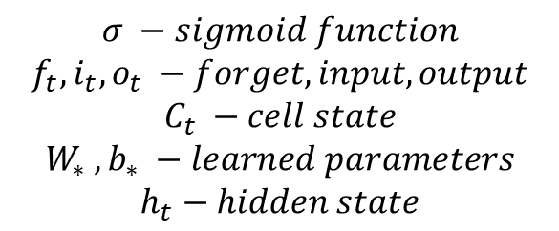
LSTM – long short-term memory
$$σ −sigmoid function$$
$$f_{t},i_{t},o_{t} −forget, input,output$$
$$C_{t} −cell state$$
$$W_{∗} ,b_{∗} −learned parameters$$
$$h_{t}−hidden state$$

Slide 10
CODE EXAMPLE
CODE EXAMPLE

Slide 11
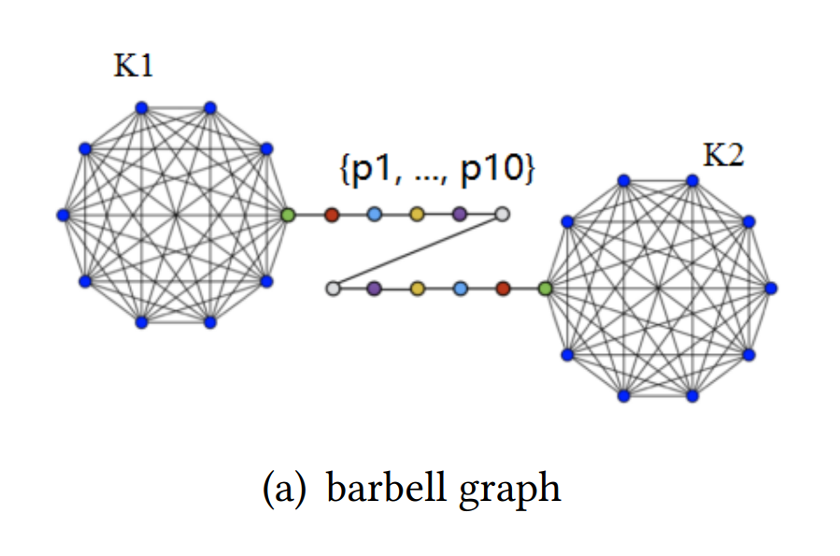
Code EXAMPLE – dataset 1

Slide 12
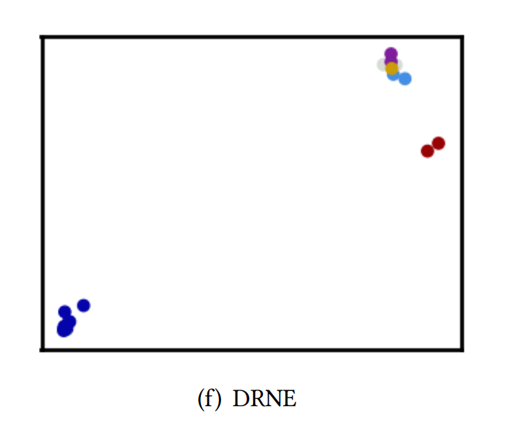
Code EXAMPLE – output 1

Slide 13
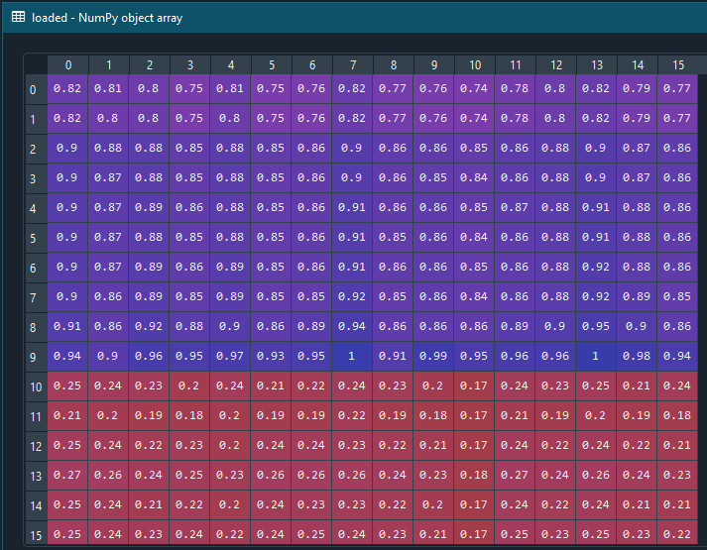
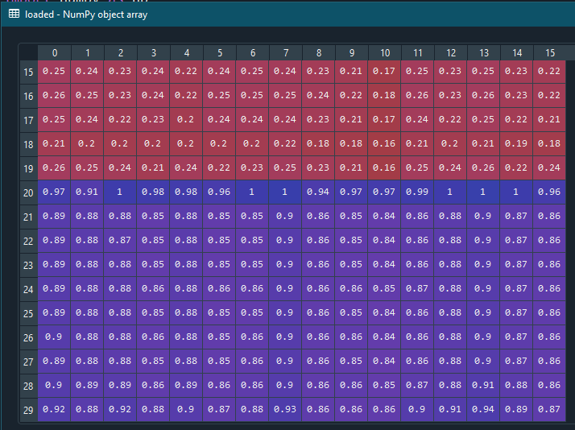
Code EXAMPLE – output 1

Slide 14
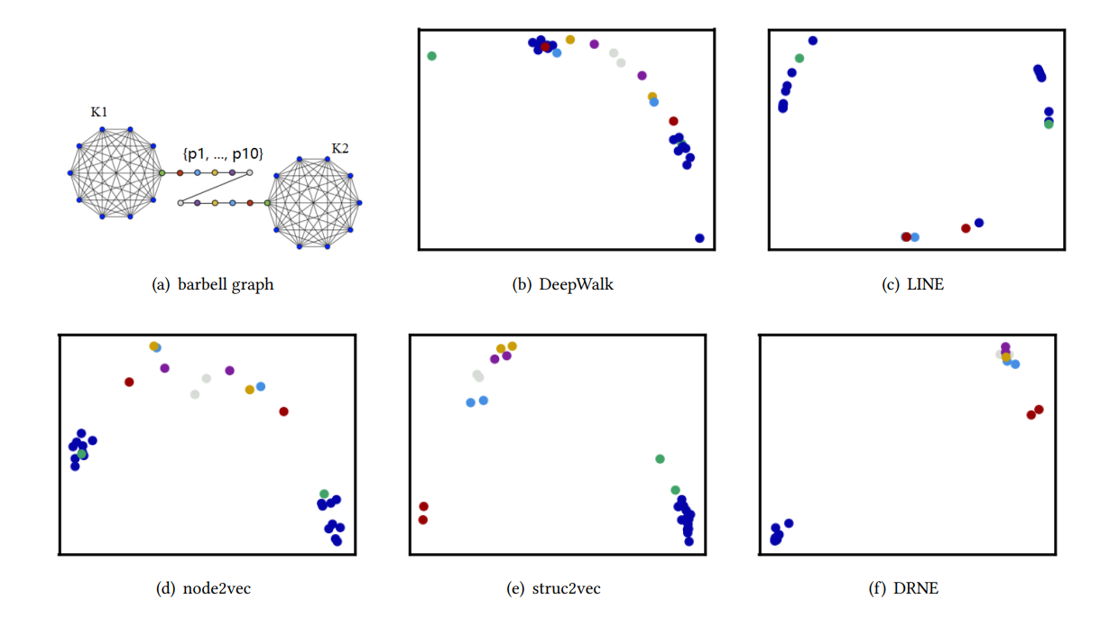
Code EXAMPLE – output compare

Slide 15
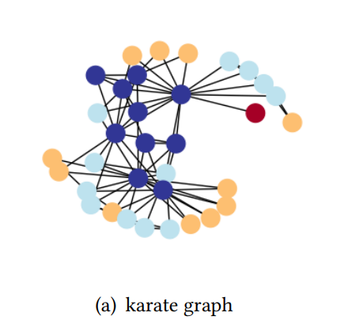
Code EXAMPLE – dataset 2

Slide 16
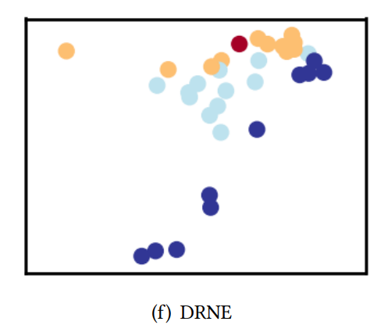
Code EXAMPLE – output 2

Slide 17
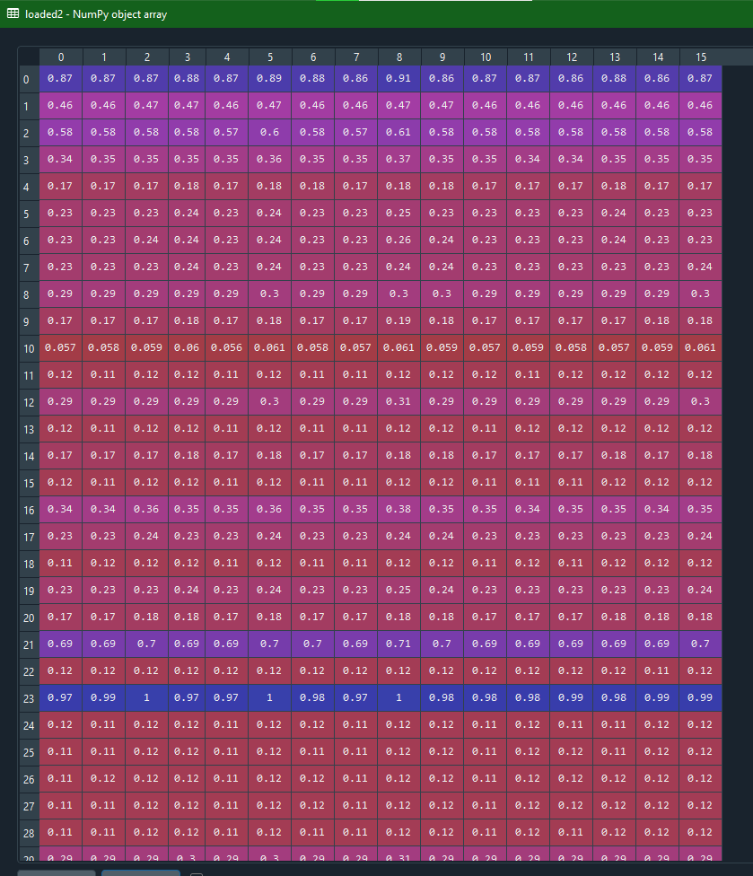
Code EXAMPLE – output 2

Slide 18
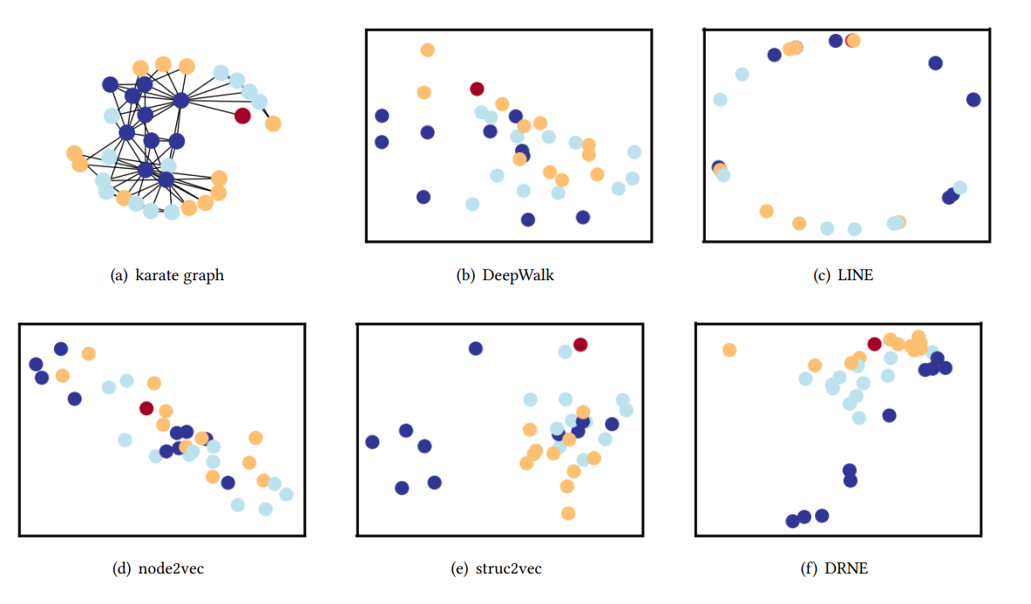
Code EXAMPLE – output 2 compare

